Slide 1


Review of Sustainability (WP7)
23 June 2021
Authors: Andy Götz (coordinator)+ Ornela Degiacomo (WP7 leader)
Place: PaNOSC Project Management Committee zoom meeting
This project has received funding from the European Union’s Horizon 2020 research and innovation programme under grant agreement No. 823852

Slide 2



Sustainability concerns ALL Work Packages

Slide 3
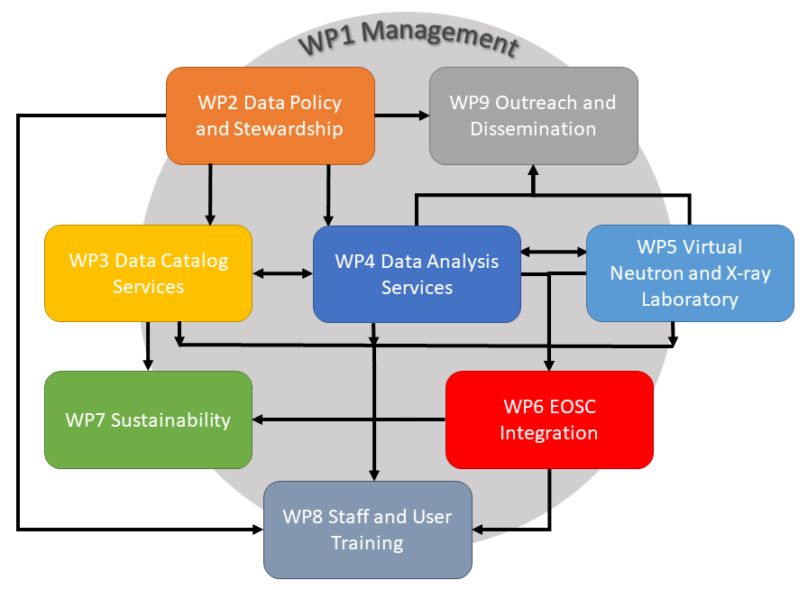
WP7
Data Catalog Services – their role in PaNOSC
This project has received funding from the European Union’s Horizon 2020 research and innovation programme under grant agreement No. 823852

Slide 4
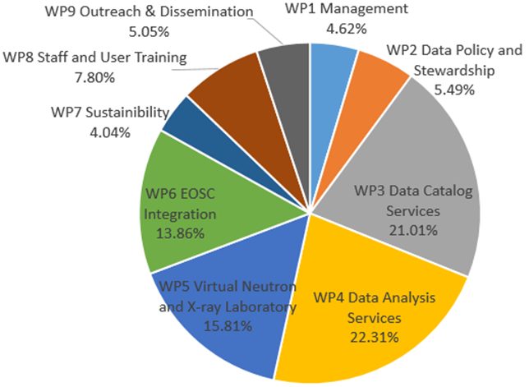
WP7
Data Catalog Services – 2nd largest WP of PaNOSC
This project has received funding from the European Union’s Horizon 2020 research and innovation programme under grant agreement No. 823852

Slide 5
WP7
Sustainability – Effort per partner
1 - CERIC-ERIC 32.00-X (WP leader)
2 - ELI-DC 12.00
3 - ESRF 3.00
4 - ESS 3.00
5 - European XFEL 3.00
6 - ILL 3.00
7 – EGI.EU 3.00
Total 56.00 (~ 4.6 years)
This project has received funding from the European Union’s Horizon 2020 research and innovation programme under grant agreement No. 823852

Slide 6
WP7 Objectives from Proposal
Propose a business plan on how to sustain the data catalogs and services in the Photon and Neutron community and as part of the EOSC. In particular:
Coordination with national or international related initiatives and support to the deployment of global and sustainable approaches in the field including coordination with EGI and the other EOSC stakeholders like RDA, the PaNdata community and LEAPS
Study - even by using advanced methodologies - of the cost per partner for maintaining the infrastructure required for providing FAIR data (archiving, data services etc.) and explore different scenarios for financing the long term costs.

Slide 7
Sustainability
WP7
Stakeholders for the Photon and Neutron community
The database of stakeholders will be used to involved stakeholders and get feedback via targeted questionnaires and interviews. The feedback from stakeholders will allow us to address the other tasks
Metrics and cost for the Photon and Neutron community
Analysis and development of metrics for the evaluation of costs and added value of the services provided to the community . We are currently working at the development of an auditable cost model template and metrics to evaluate the added value of services which will be computed by tools like PUMA, VUO and others
This project has received funding from the European Union’s Horizon 2020 research and innovation programme under grant agreement No. 823852

Slide 8
PUMA publication metrics
Publications and citations per instrument
Delay between a proposal and a publication
Countries and laboratories which use ILL (ESRF, …) data
Look for potential new users
Scientific trends
Impact factor per science facility
This project has received funding from the European Union’s Horizon 2020 research and innovation programme under grant agreement No. 823852

Slide 9

Stakeholders
WP7
PaN user community
EOSC bodies
EOSC Secretariat
EOSC Governing Board
EOSC Executive Board
EU PaN sources
PaNOSC partners / bodies & national PaN RIs (managers, bodies, staff, IT professionals)
Media &
general public
EC, national authorities and funding agencies, policy makers
Community of RIs from other clusters
ENVRI-FAIR
EOSC-LIFE
ESCAPE
SSHOC
e-infrastructures
EGI
Géant
PRACE
RDA Europe
Other EOSC-related projects
EOSC-Hub
GO FAIR
FAIRsFAIR
OpenAIRE
Researchers from academia & industry
PRACE
host members
ERICs’ community
ERIC Forum
ESFRI
This project has received funding from the European Union’s Horizon 2020 research and innovation programme under grant agreement No. 823852

Slide 10
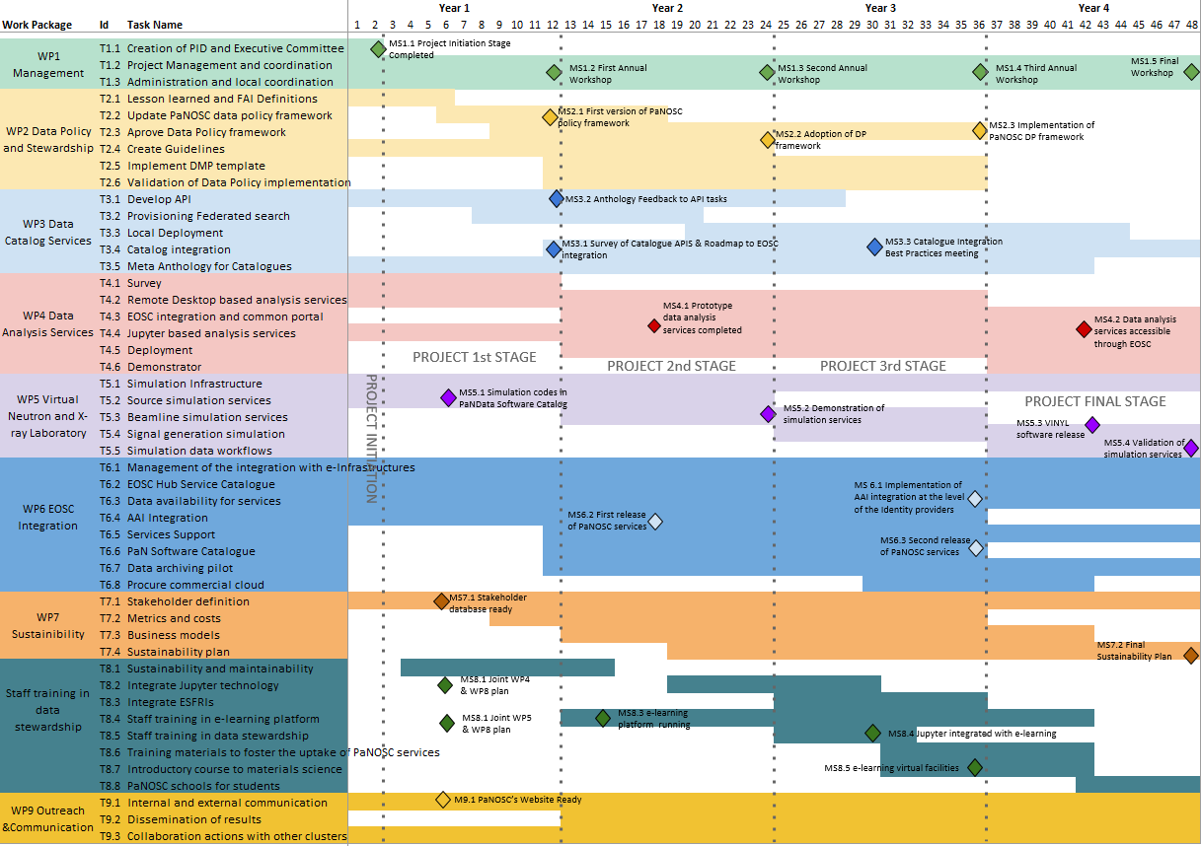
May 2021
PaNOSC Milestones

Slide 11
PaNOSC WP7 Tasks
T7.1 Task 7.1 Stakeholders for the PaN community EOSC (M1-M48)
T7.2 Metrics and cost for the PaN community EOSC (M9-M36)
T7.3 Business models for PaN EOSC (M13-M42)
T7.4 Sustainability plan for the PaN EOSC (M19-M48)

Slide 12
PaNOSC WP7 Deliverables
D7.1 Photon and Neutron EOSC Stakeholder Feedbacks (M18, R, PU, CERIC-ERIC)
D7.2 PaN EOSC metrics and costs model (M36, R, PU, CERIC-ERIC)
D7.3 PaN EOSC Business model reference document (M42, R, PU, CERIC-ERIC)
D7.4 PaN EOSC Sustainability plan (M48, R, PU, CERIC-ERIC)

Slide 13
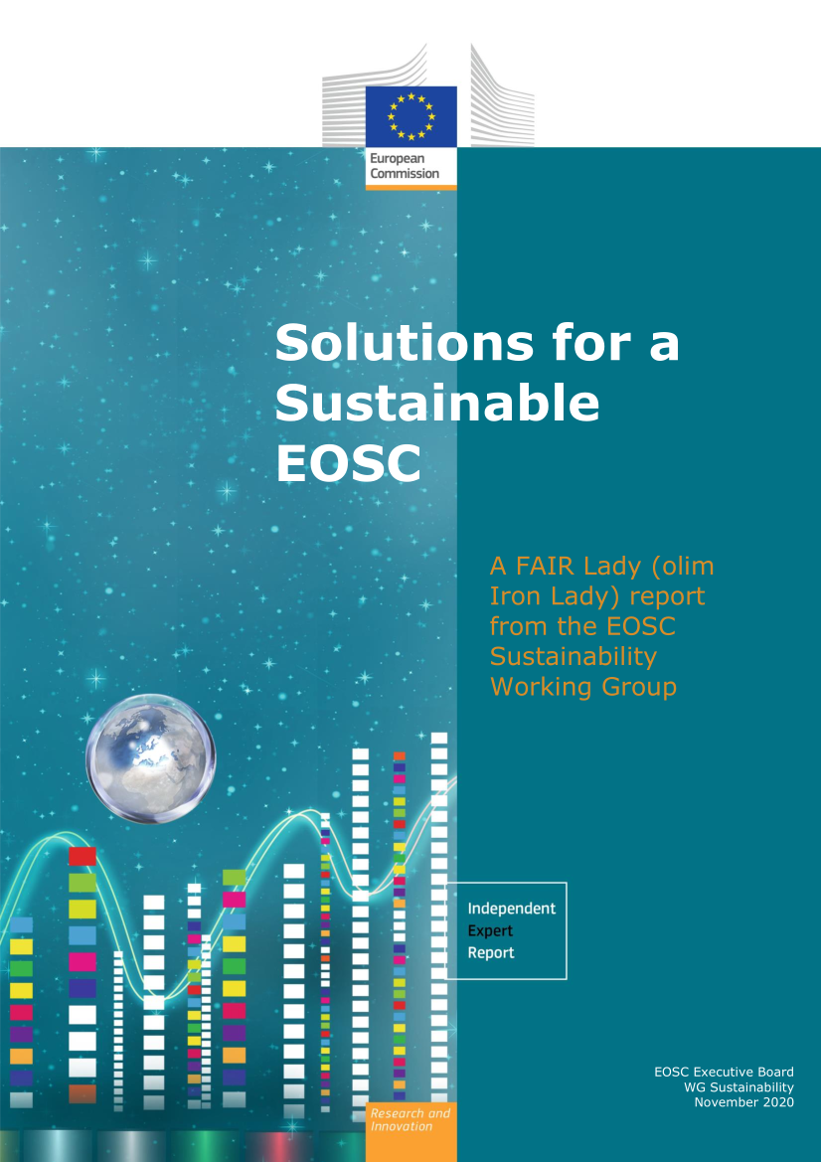
EOSC Sustainability report
The interim findings of the FAIR Forever study by DPC32, noted that digital preservation is not explicit in the context of EOSC and the roles, responsibilities and accountability for digital preservation are currently not clearly defined.
The cost of operating EOSC-Exchange (but not the cost of operating the services it contains) will be included in the EOSC-Core funding model.
Funds for developing, operating and maintaining the services included in EOSC-Exchange is principally the responsibility of the service providers that operate them.

Slide 14
PaNOSC Use Case
PaNOSC
Contribution to the realisation of a data commons for Neutron and Photon science, providing Open Data services and tools for data storage, analysis and simulation, for the many scientists from existing and future disciplines using data from photon and neutron sources. This use case demonstrates the potential for innovative SME bridging organisations to translate large amounts of specialist scientific data to meet the needs of industry research and product development, and the potential for new markets to emerge based on European research.

Slide 15
Inventory of what needs to be sustained
Data catalogs – SciCat, Icat, local ingestion + archiving
Data format – HDF5, Nexus, compression filters
Data portals – search API + portal + browser (h5web)
Data transfer – download + transfer services
Data Analysis – VISA portal, Jupyterlab + Binder
Authentication + Authorisation Infrastructure – Umbrella AAI
Data Analysis software – software in pan-software catalog
Simulation software – SIMEX, OASYS, notebooks, workflows
Training platform – pan-learning.org, pan-training.org, training

Slide 16
WP | Main activities | FTE per year | Other costs per year
2 | Harmonisation: one meeting every six months | 1 meeting every six months
 | Implementation of the data policy | 2FTE | 100.000 (not per year)
3 | Keep the search service running at the facility | 0.5-1 FTE per facility
 | Maintain the federated service | 0.5-1 FTE?(included in the maintenance of the portal?)
 | New developments | Not determined
4 | Data portal/data analysis tool and resources Hypothesis 1: maintain what was developed by PaNOSC | 1FTE per facility
 | Hypothesis 2: The developments continue after PaNOSC | Not determined, but wide commitment
5 | maintain the package, without developments | 4 FTE overall
 | package should improved to be user friendly | 3 FTE overall

Slide 17
WP | Main activities | FTE per year | Other costs per year
6 | Umbrella ID | 0.1 FTE per facility | Depend on the support requested to Geant
 | Software for data transfer |  | subscription of a service agreement with the provider (Globus or IBM ASPERA). Either individually or as a community
 | For the catalogue | <0.1 FTE per facility
 | Helpdesk | To be determined
8 | Training portal fixed costs | 2 FTE overall | Hosting: few keuros Licensing costs; less than 1000 euros
 | Training portal variable costs |  | 100 simultaneous users: 3.000 – 4.000 EUR on prem per year (on-prem) / 7.500 – 10.000 EUR per year (cloud) 1000 simultaneous users: 30.000 – 40.000 EUR on prem per year (on-prem) / 75.000 – 100.000 EUR per year (cloud)
 | Support to integration of new partners | TBD
 | Helpdesk | TBD
9 | All facilities will need to contribute with material. | 1-2 FTE per facility | 50.000-100.000 euros
 | one facility maintains the link with the other clusters. | 1-2 FTE overall

Slide 18
Possible business models for the PaN services
Project funding -> for new developments (not operation)
Agreements between RIs
Agreements including other funding agencies
Agreements with third parties
New legal entity
Service costing activities need to move beyond FTE based project accounting in order to establish more accurate estimates of costs for service operation and future development.

Slide 19
ESFRIs EOSC contribution already funded?
Under the Research Infrastructures Work Programme of Horizon 2020, the EC has provided support to actions that connect the ESFRI infrastructures to EOSC and promoted research data sharing by default.
This implies that PaNOSC partners are already funded for the EOSC …

Slide 20
EOSC recognizes that RIs are funded for their community of users
It is recognised that the services provided by publicly funded organisations frequently have a mandate and a budget to serve a well-defined set of users that may be delimited by research discipline or geographical boundaries, and that broadening access to those services may generate additional costs.
As an incentive to encourage service providers to participate in EOSC-Exchange and open up their services to all publicly funded researchers, the projects to be funded via calls such as INFRAEOSC-07-2020 will offer an EC-funded means, based on the Horizon 2020 Virtual Access71 scheme, to compensate service providers for the additional operational costs they incur.
The Virtual Access (VA) instrument is provided by the European Commission to increase the sharing of research infrastructures and services that otherwise would not be available to international user groups. In VA, the services – also called “installations” – have to be made available ‘free of charge at the point of use’ for European or International researchers. VA access is open and free access to services through communication networks to resources needed for research, without selecting the researchers to whom access is provided.

Slide 21
What are the issues for sustainability ?
Need to sustain what has been developed
Lack of accounting and business models
Lack of engagement and commitment for the future i.e. we need more data managers
Danger of pushing sustainability to the future and not sustaining the basic services

Slide 22
PaNOSC WP7 spending up to 31/3/2021
WP7
Q: what is each partner doing for WP7?

Slide 23
The solution
Best way of ensuring sustainability is to integrate the PaNOSC solutions into the production services offered to users
Need a stronger commitment to Open Science i.e. make it an integral part of what RIs do
The Challenge is to convince top management to make this commitment

